Slide 1

Extraction of assembly information from instruction manuals
Language Processing and Information Extraction
February, 2017
Carlos Miguel Correia da Costa – carlos.costa@fe.up.pt

Slide 2
Presentation outline
Introduction
Context
Objectives
Related work
Dataset sources
Dataset preparation
NER processing pipeline
CRF training and testing
Feature selection
CRF performance analysis
Text annotation
Entity extraction
Conclusions
Future work

Slide 3
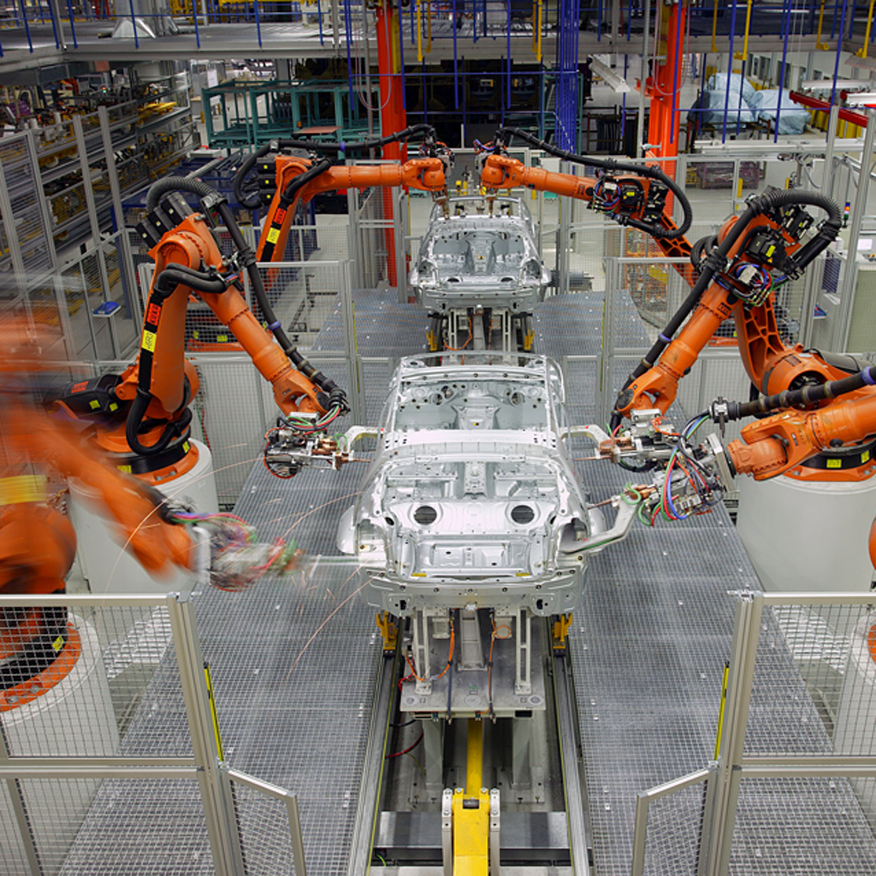
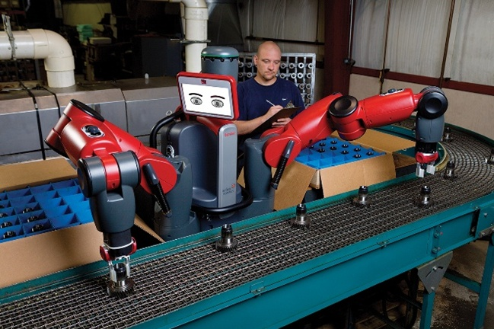
1.a. Context
Introduction
Assembly of complex objects by robots requires long programming periods
Teaching new assembly skills by demonstration can significantly reduce the cost of repurposing robots for building new products
Automatic extraction of assembly knowledge from instruction manuals can speed up the learning process
Car assembly line
Packaging line

Slide 4
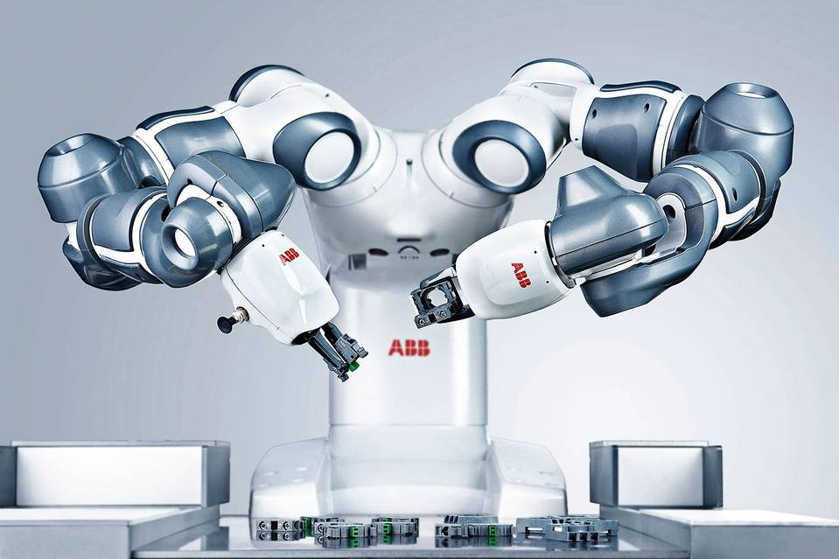
1.b. Objectives
Introduction
Development of an information extraction system capable to recognize:
The objects being assembled and their parts
Tools necessary to perform the assembly
The assembly order
The spatial relations between the assembly parts
Small parts assembly robot

Slide 5
2.a. Related work
Related work
Extraction of assembly information from written natural language
Uses multilingual semantic and syntactic parser and also coreference chains
Relies on ontologies for modeling objects, robots, sensors
Extraction of predicate-argument structures from text that are associated with robot manipulation skills
Identification of assembly objects and spatial constraints
Creation of high level symbolic task sequences
Generation of code for performing robot arm manipulation
Stenmark, M.; Nugues, P., "Natural language programming of industrial robots“, in Robotics (ISR), 2013 44th International Symposium on , vol., no., pp.1-5, 24-26 Oct. 2013, doi: 10.1109/ISR.2013.6695630
Natural language processing pipeline for assembly of small objects

Slide 6
2.b. Related work
Related work
Extraction of tasks from natural language for autonomous robot missions
Text in structured format (five paragraphs with [situation], [mission], [execution], [service support] and [command and signals])
The goal is to identify named entities useful for mission, such as persons, times, locations, coordinates, targets and organizations
Processing pipeline
Extraction of plain text from .pdf and .doc files followed by tokenization
Usage of Condition Random Fields from jCarafe with the following features:
Word lists, regular expressions, prefixes / suffixes, word case, unigram / bigram / trigrams
CRF created using 9-fold cross validation
NER evaluation using precision (0.702), recall (0.478) and F-measure (0.569)
D. Chesworth, N. Harmon, L. Tanner, S. Guerlain and M. Balazs, "Named-entity recognition and data visualization techniques to communicate mission command to autonomous systems“, 2016 IEEE Systems and Information Engineering Design Symposium (SIEDS), Charlottesville, VA, 2016, pp. 233-238. doi: 10.1109/SIEDS.2016.7489305

Slide 7
2.c. Related work
Related work
SpeedRead - Fast Named Entity recognition pipeline
Penn Tree bank compliant tokenizer
Part-of-Speech (POS) tagger using Condition Random Fields model
Knowledge-based named entity recognizer
Used F1 score for evaluation
Was 10 times faster than the Stanford NER in 2012
Rami Al-Rfou, Steven Skiena, “SpeedRead: A Fast Named Entity Recognition Pipeline”, in 24th International Conference on Computational Linguistics, 2012

Slide 8
2.d. Related work
Related work
Using gazetteers in discriminative information extraction
Improvement of gazetteers effectiveness using:
Feature normalization
Combination of two CRFs using a logarithmic opinion pool approach
One CRF trained with and another without gazetteer features
Combination approach similar to a mixture model but uses weighted multiplicative combination of models instead of a weighted additive combination
A. Smith and M. Osborne, "Using gazetteers in discriminative information extraction" in Tenth Conference on Computational Natural Language Learning, 2006

Slide 9
2.e. Related work
Related work
Integrating language, vision and action for human robot dialog systems
Multi-agent system capable of learning new skills by analyzing human voice commands, gestures and gaze
Speech recognition relied on a Combinatorial Categorial Grammar (CCG) and was used to analyze:
Imperative sentences
Questions
Statements
Confirmations
Vision system used template matching techniques
M. Rickert, M. E. Foster, M. Giuliani, T. By, G. Panin, and A. Knoll, "Integrating language, vision and action for human robot dialog systems" in International Conference on Universal Access in Human-Computer Interaction, 2007

Slide 10
2.f. Related work
Related work
Understanding and executing instructions for everyday manipulation tasks from the world wide web
Syntactic and sematic analysis
Using a Probabilistic Context Free Grammar (PCFG) parser and a Part of Speech (PoS) tagger
Word sense retrieval and disambiguation
Using a WordNet database and a Cyc ontology
Validation of instructions retrieved from the text using a simulator
Generation of valid and verified assembly plans
M. Tenorth, D. Nyga, and M. Beetz, “Understanding and executing instructions for everyday manipulation tasks from the world wide web”, in International Conference on Robotics and Automation, 2010

Slide 11
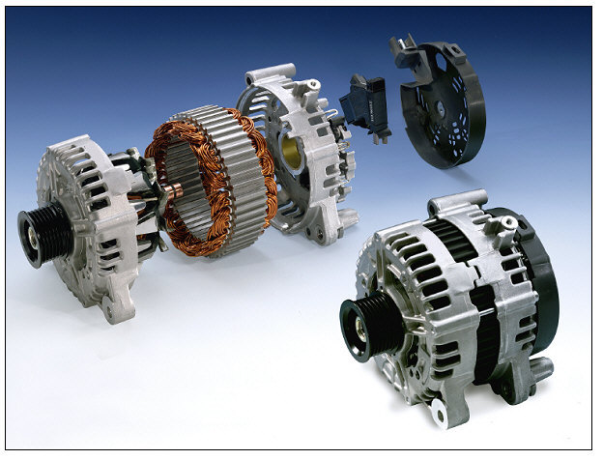
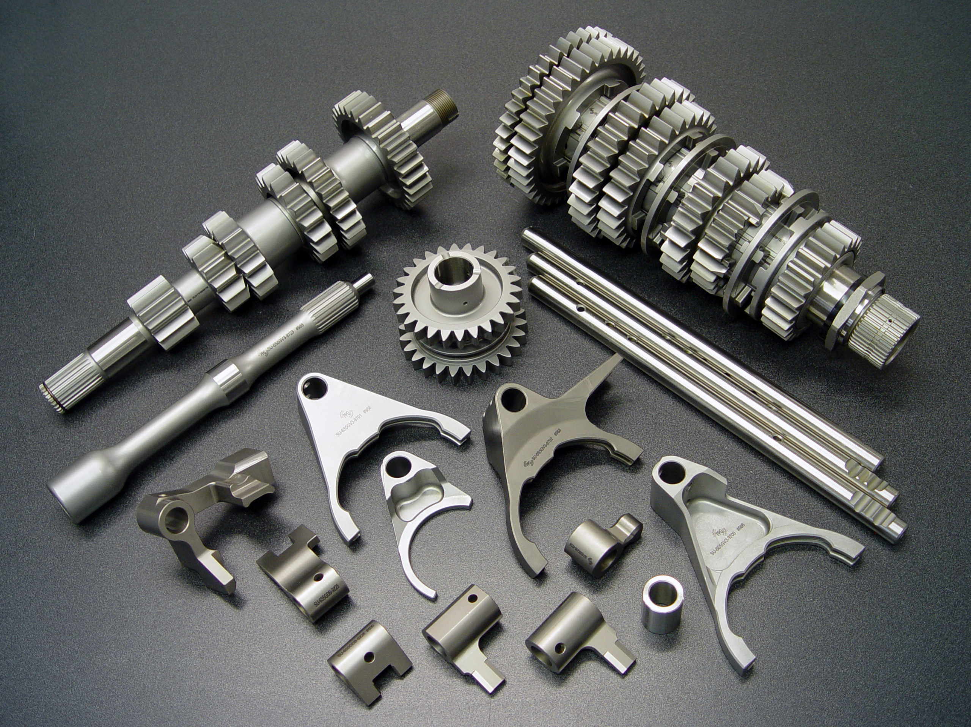
3.a. Dataset text categories
Dataset sources
Dataset with assembly instructions for 3 different types of objects:
Alternators
Engines
Gearboxes
Engine
Alternator
Gearbox

Slide 12
3.b. Dataset overview
Dataset sources
Alternators
84 pages
56185 characters
Engines
148 pages
131287 characters
Gearboxes
221 pages
192424 characters

Slide 13
4.a. Preprocessing
Dataset preparation
Extraction of text from pdfs
Manual verification / correction of text to ensure correct multi-column text extraction
Selection of assembly procedures
Removal of pages formatting text
Creation of validation files with all the assembly parts and their associated quantity for each assembly procedure

Slide 14
4.b. Corpus annotation
Dataset preparation
Manual annotation of a representative part of the dataset at the token level (tsv format)
9 categories of entities annotated in the corpus
Assembly part (PART)
Relative position of parts (RPOS)
Tools required for assembly (TOOL)
Operations performed (OPER)
Part IDs (ID)
Part quantity (QTY)
Part dimension (DIM)
Part weight (WGT)
Part properties (PROP)
Creation of train (20370 tokens - 84%) and test (3877 tokens - 16%) corpus

Slide 15
4.b. Corpus annotation
Dataset preparation
 | Alternators | Engines | Gearboxes | Global
No of train tokens | 4450 | 9101 | 6819 | 20370
No of test tokens | 781 | 1852 | 1344 | 3977
No of PART train tokens | 738 | 1709 | 1477 | 3924
No of PART test tokens | 156 | 372 | 327 | 855
No of RPOS train tokens | 83 | 258 | 546 | 887
No of RPOS test tokens | 25 | 52 | 96 | 173
No of TOOL train tokens | 72 | 33 | 33 | 138
No of TOOL test tokens | 5 | 11 | 0 | 16
No of OPER train tokens | 182 | 342 | 435 | 959
No of OPER test tokens | 30 | 73 | 72 | 175
No of ID train tokens | 2 | 49 | 76 | 127
No of ID test tokens | 0 | 35 | 138 | 173
No of QTY train tokens | 45 | 41 | 70 | 156
No of QTY test tokens | 4 | 22 | 23 | 49
No of DIM train tokens | 0 | 67 | 0 | 67
No of DIM test tokens | 0 | 5 | 0 | 5
No of WGT train tokens | 0 | 2 | 0 | 2
No of WGT test tokens | 0 | 0 | 0 | 0
No of PROP train tokens | 36 | 63 | 2 | 101
No of PROP test tokens | 13 | 2 | 0 | 15
Overview of manually annotated dataset at the token level (tsv format)

Slide 16
5.a. CRF training and testing
Processing pipeline
Training of the Stanford NER system using the manually annotated train corpus
Fine tuning of the CRF features by evaluating the precision, recall and F1 metrics of the CRF model when using the testing corpus
Starting from the recommended configuration, it was performed 91 tests in which a given feature was activated, deactivated or fine tuned
The best configuration achieved an improvement over the recommended features of 3.23 % in F1, 5.79% in recall and 0.35% in precision, resulting in an overall performance of 84.69% in F1, 83.51 in recall and 85.91 in precision

Slide 17
5.b. CRF feature selection
Processing pipeline
Test folder | Changed Parameter | Recommended Value | Test Value | Train time (sec) | Classifier test Speed (words/sec) | Precision | Recall | F1
0-recommended-properties | - | - | - | 125,5 | 3798,47 | 0,8556 | 0,7772 | 0,8146
93-optimal-configuration | - | - | - | 176,4 | 4581,8 | 0,8591 | 0,8351 | 0,8469
41-lowercaseNGrams-true | lowercaseNGrams | FALSE | TRUE | 142,5 | 3929,84 | 0,8662 | 0,7927 | 0,8278
29-wordShape-chris2 | wordShape | chris2useLC | chris2 | 130 | 4332,24 | 0,858 | 0,7985 | 0,8272
15-useDisjunctive-false | useDisjunctive | TRUE | FALSE | 137,23 | 4217,39 | 0,867 | 0,7859 | 0,8245
21-wordShape-dan1 | wordShape | chris2useLC | dan1 | 161,1 | 4389,62 | 0,8589 | 0,7927 | 0,8245
5-noMidNGrams | noMidNGrams | TRUE | FALSE | 136,2 | 3658,69 | 0,8549 | 0,7956 | 0,8242
34-wordFunction-Lowercase AndAmericanizeFunction | wordFunction | null | LowercaseAnd AmericanizeFunction | 138,3 | 3980,98 | 0,8515 | 0,7965 | 0,8231
2-useClassFeature-false | useClassFeature | TRUE | FALSE | 125 | 3455,26 | 0,8617 | 0,7869 | 0,8226
22-wordShape-chris1 | wordShape | chris2useLC | chris1 | 159,6 | 4013,12 | 0,8568 | 0,7907 | 0,8225
18-useTypeSeqs-false | useTypeSeqs | TRUE | FALSE | 118,9 | 4121,24 | 0,8597 | 0,7859 | 0,8212
31-wordShape-chris3 | wordShape | chris2useLC | chris3 | 118,5 | 4230,85 | 0,8509 | 0,7927 | 0,8208
7-maxNGramLeng-7 | maxNGramLeng | 6 | 7 | 128,6 | 4058,16 | 0,8603 | 0,784 | 0,8204
Some of the tuning tests that improved the F1 score over the recommended configuration

Slide 18
5.b. CRF feature selection
Processing pipeline
Test folder | Changed Parameter | Recommended Value | Test Value | Train time (sec) | Classifier test Speed (words/sec) | Precision | Recall | F1
0-recommended-properties | - | - | - | 125,5 | 3798,47 | 0,8556 | 0,7772 | 0,8146
93-optimal-configuration | - | - | - | 176,4 | 4581,8 | 0,8591 | 0,8351 | 0,8469
9-maxNGramLeng-4 | maxNGramLeng | 6 | 4 | 143 | 4074,8 | 0,843 | 0,756 | 0,7972
80-sigma-5 | sigma | 1 | 5 | 334,9 | 3751,89 | 0,8358 | 0,7608 | 0,7966
10-maxNGramLeng-3 | maxNGramLeng | 6 | 3 | 128,9 | 4370,33 | 0,839 | 0,7435 | 0,7883
39-useMoreNeighborNGrams-true | useMoreNeighborNGrams | FALSE | TRUE | 141 | 3933,73 | 0,8348 | 0,7454 | 0,7876
79-sigma-10 | sigma | 1 | 10 | 412,8 | 4112,72 | 0,8328 | 0,7348 | 0,7807
11-maxNGramLeng-2 | maxNGramLeng | 6 | 2 | 132,6 | 4199,58 | 0,8247 | 0,7213 | 0,7695
78-sigma-20 | sigma | 1 | 20 | 630,6 | 4212,92 | 0,823 | 0,7175 | 0,7666
77-sigma-30 | sigma | 1 | 30 | 758,13 | 3748,35 | 0,8145 | 0,7155 | 0,7618
76-useBagOfWords-true | useBagOfWords | FALSE | TRUE | 6362,6 | 497,56 | 0,6951 | 0,8264 | 0,7551
4-useNGrams-false | useNGrams | TRUE | FALSE | 148,9 | 3827,72 | 0,8138 | 0,6914 | 0,7477
12-maxNGramLeng-1 | maxNGramLeng | 6 | 1 | 138 | 4177,52 | 0,8138 | 0,6914 | 0,7477
Some of the tuning tests that decreased the F1 score over the recommended configuration

Slide 19
5.c. CRF performance analysis
Processing pipeline
Entity | Precision | Recall | F1 | True positives | False positives | False negatives
DIM | 0.0714 | 0.5000 | 0.1250 | 1 | 13 | 1
ID | 0.9886 | 0.9158 | 0.9508 | 87 | 1 | 8
OPER | 0.8896 | 0.8286 | 0.8580 | 145 | 18 | 30
PART | 0.8513 | 0.7740 | 0.8108 | 435 | 76 | 127
PROP | 0.8889 | 0.5333 | 0.6667 | 8 | 1 | 7
QTY | 0.3333 | 0.1724 | 0.2273 | 5 | 10 | 24
RPOS | 0.8777 | 0.8188 | 0.8472 | 122 | 17 | 27
TOOL | 1.0000 | 0.3000 | 0.4615 | 3 | 0 | 7
Totals | 0.8556 | 0.7772 | 0.8146 | 806 | 136 | 231
NER results using the recommended configuration

Slide 20
5.c. CRF performance analysis
Processing pipeline
Entity | Precision | Recall | F1 | True positives | False positives | False negatives
DIM | 0.0625 | 0.5000 | 0.1111 | 1 | 15 | 1
ID | 0.9892 | 0.9684 | 0.9787 | 92 | 1 | 3
OPER | 0.8935 | 0.8629 | 0.8779 | 151 | 18 | 24
PART | 0.8667 | 0.8327 | 0.8494 | 468 | 72 | 94
PROP | 0.6000 | 0.6000 | 0.6000 | 9 | 6 | 6
QTY | 0.5926 | 0.5517 | 0.5714 | 16 | 11 | 13
RPOS | 0.8681 | 0.8389 | 0.8532 | 125 | 19 | 24
TOOL | 1.0000 | 0.4000 | 0.5714 | 4 | 0 | 6
Totals | 0.8591 | 0.8351 | 0.8469 | 866 | 142 | 171
NER results using the fine tuned configuration

Slide 21
5.d. Text annotation
Processing pipeline
After having a fine tuned CRF model, new unseen text (from the test corpus) was annotated with inline xml tags.
Example of inline xml text annotation bellow:
<OPER>Align</OPER> <PART>mounting lugs</PART> and <OPER>assemble</OPER> <QTY>two</QTY> halves of <PART>alternator</PART> (See Fig. 37), inserting <PART>rectifier end bearing</PART> <RPOS>inner</RPOS> <PART>race</PART> (on <PART>rotor shaft</PART>) <RPOS>into</RPOS> <PART>bearing</PART> in <PART>rectifier end housing</PART> (1). <PART>Seat drive end housing</PART> (4) at this time. Using <TOOL>arbor press</TOOL> and appropriate <PART>block</PART> to apply even pressure on end frames.

Slide 22
5.e. Entity extraction
Processing pipeline
After having the text annotated, the entities were extracted and split into classes. This allows to quickly see the assembly order of parts.
Moreover, it is also provided the entity lists sorted and without duplicates (useful to analyze the type of operations or tools needed).

Slide 23
6. Conclusions
From this project resulted:
A new NER dataset for assembly operations in the tsv format
A detailed analysis of the features of the Stanford NER system
The fine tuning of the Stanford NER system for the new dataset
The Stanford NER achieved recognition results high enough for being applied in higher level processing systems, such as extraction of assembly operations and learning of new skills by robotic systems

Slide 24
7. Future work
After having a dataset and a NER system with high recognition performance, future work could include:
Generation of the assembly graph for the assembly operations with associated metadata
Association of the recognized entities with the CAD models of the assembly parts and tools
Semi-supervised learning of the CRF language models for faster deployment of the system to a broad application domain

Slide 25
Questions?
Thank you!

